Slide 1
Networks
Functional Networks
Graph Theory
Frédéric Zubler
Inselspital
Benesco 07.12.2018
Notes:
In his very interesting talk, Serge presented us networks.
We all understand intuitively what a network is. But how is it precisely defined?
In mytalk, I will show you how networks can be represented mathemathically using graph theory

Slide 2
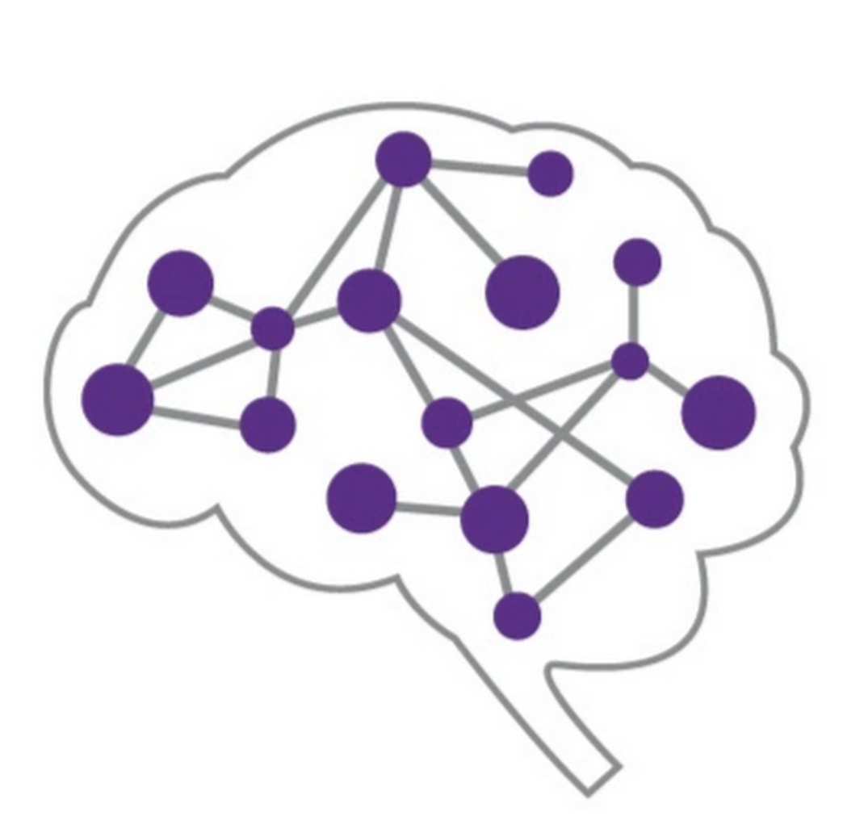
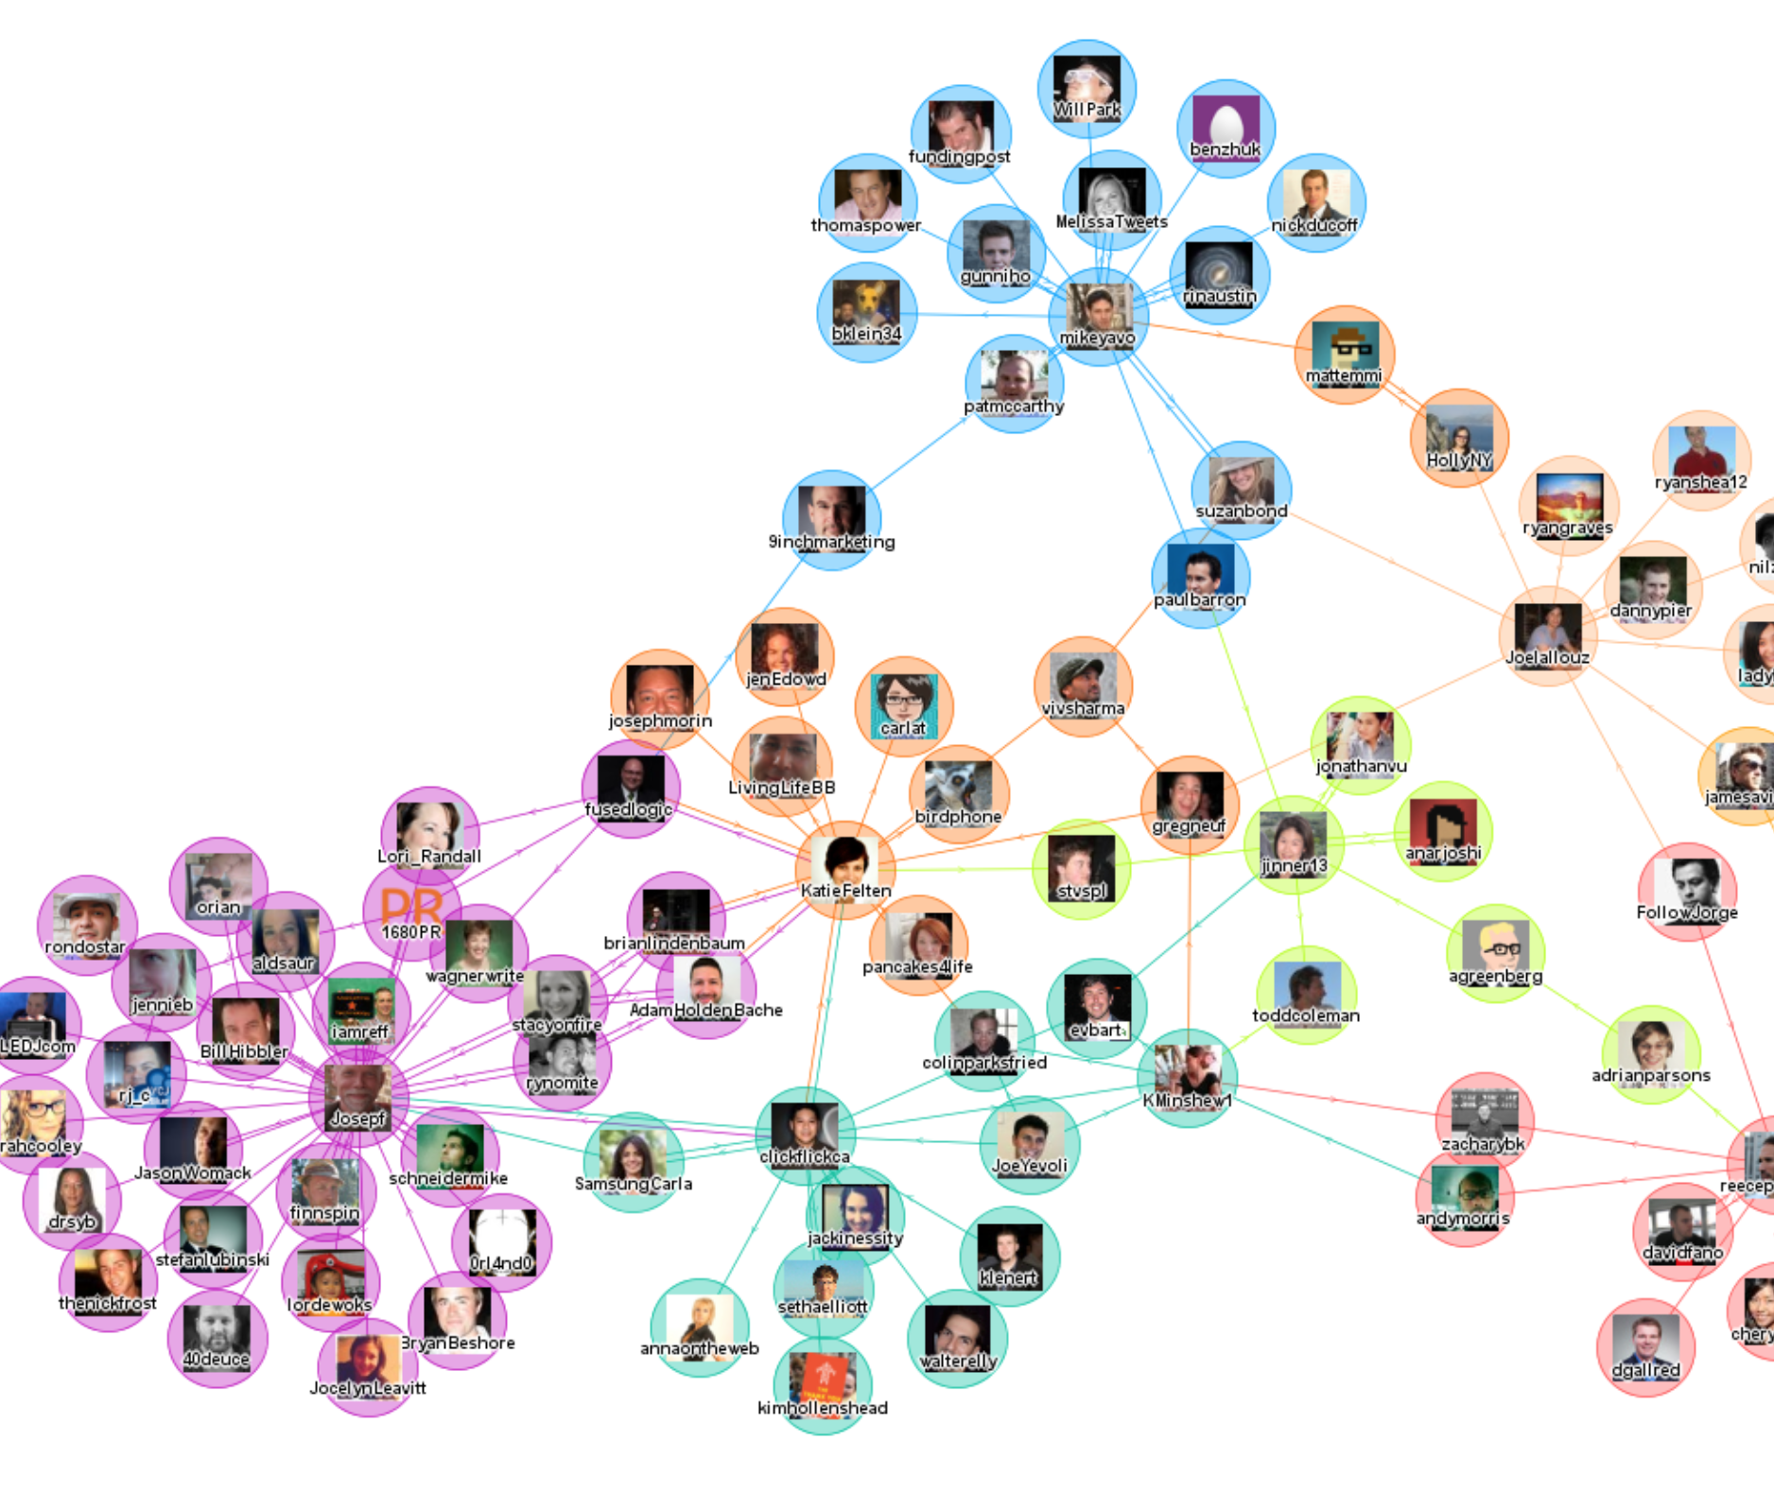
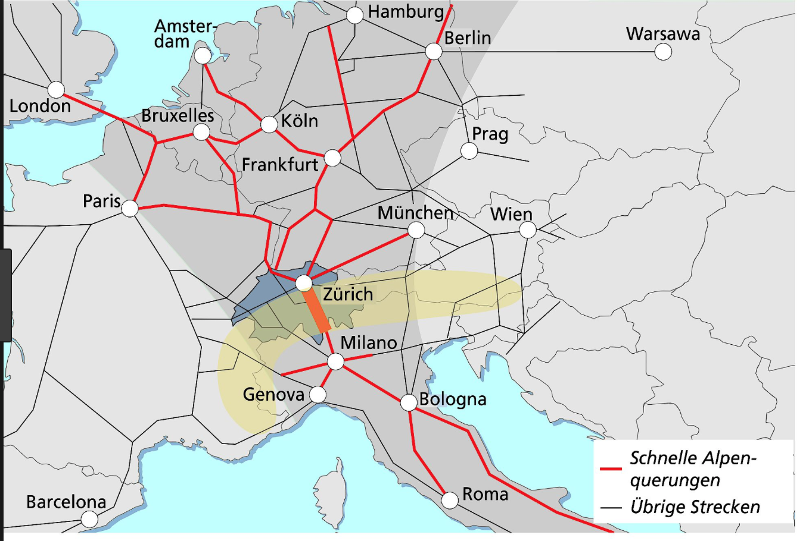
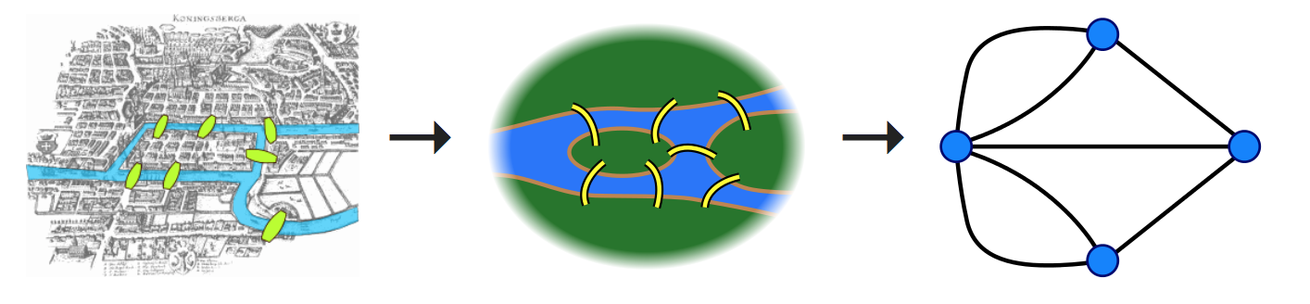

Slide 3
Definition of a graph
A graph is :
- a collection of objects, called nodes (vertex/vertices)
- a set of connections between pairs of nodes, called links (or edges).
Ein Graph ist :
- eine Menge von Objekten = Knoten
-Verbindungen zwischen diesen Objekten = Kanten
Notes:
First some definitions:

Slide 4
Definition of a graph
A graph is :
- a collection of objects, called vertices or nodes
- a set of connections between pairs of nodes, called edges or links.
Example
V = {1, 2, 3, 4}
E = { (1,2), (1,3), (1,4),
(2,3), (2,4), (3,4) }
1
2
3
4

Slide 5
Definition of a graph
A graph is :
- a collection of objects, called vertices or nodes
- a set of connections between pairs of nodes, called edges or links.
Example
V = {1, 2, 3, 4}
E = { (1,2), (1,3), (1,4),
(2,3), (2,4), (3,4) }
Two different representation of the same graph !!
1
1
2
2
3
4
3
4

Slide 6
Some definitions
A graph is directed (or oriented) if edges are arrows, i.e. (a,b) ≠ (b,a).
A graph is weighted if a label (weight) is associated with each edge.
A graph is connected if there is a path from any node to any other node.
2
1
2
1
2
1
2
0.5
15
2
6
3
4
3
4
3
4
3

Slide 7
Is the following graph
directed ? i.e. (a,b) ≠ (b,a) ?
weighted ? i.e. a label is associated with each edge?
connected ? i.e. there is a path from any node to any other node?

Slide 8
Representation using a matrix
A graph can be represented by a square table, the adjacency matrix, where
(Adjazenzmatrix)
to
1 2 3 4
1
2
1
2
3
4
0 | 1 | 1 | 0
1 | 0 | 0 | 0
0 | 1 | 0 | 0
1 | 0 | 1 | 1
from
3
4
2
1
2
0 | 2 | 15 | 6
2 | 0 | 0.5 | 2
15 | 0.5 | 0 | 0
6 | 2 | 1 | 0
0.5
15
2
6
3
4
3
Notes:
A graphe can be represented using a table.
Mathematicians called such table a Matrix.
The matrix associated with graphs is the adjaceny matrix.
Here, the link between the node i and the node j is found at the the entry at ith row and jth column.

Slide 9
Centrality : identifying "important" nodes in a graph
Original Graph
Degree Centrality
(Grad)
Eigenvector Centrality

Slide 10
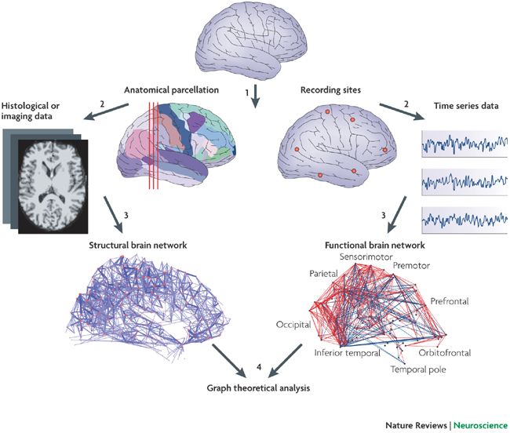
2 types of graphs in Neuroscience
structural networks :
nodes = brain areas, neurons, ...
links = anatomical connections
functional networks :
nodes = signals (EEG, fMRI,...)
links = mathematical relation
between signals
Bullmore & Sporns, 2009

Slide 11
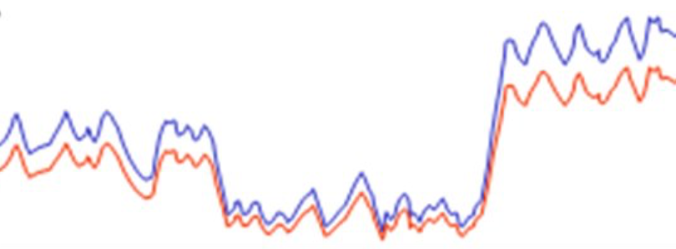
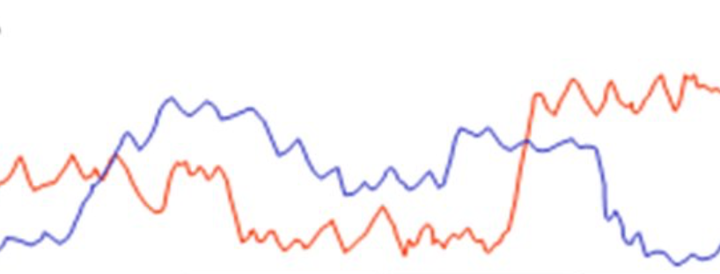
A measure of synchronization: correlation

Slide 12
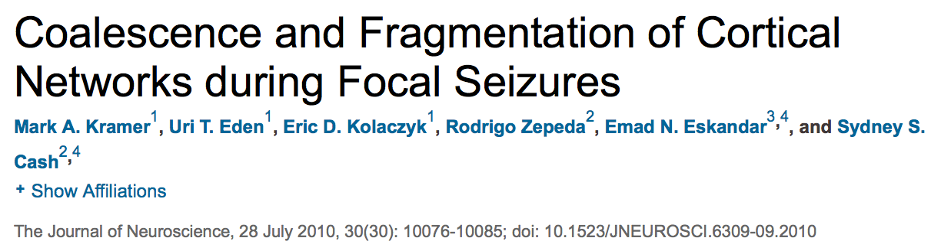
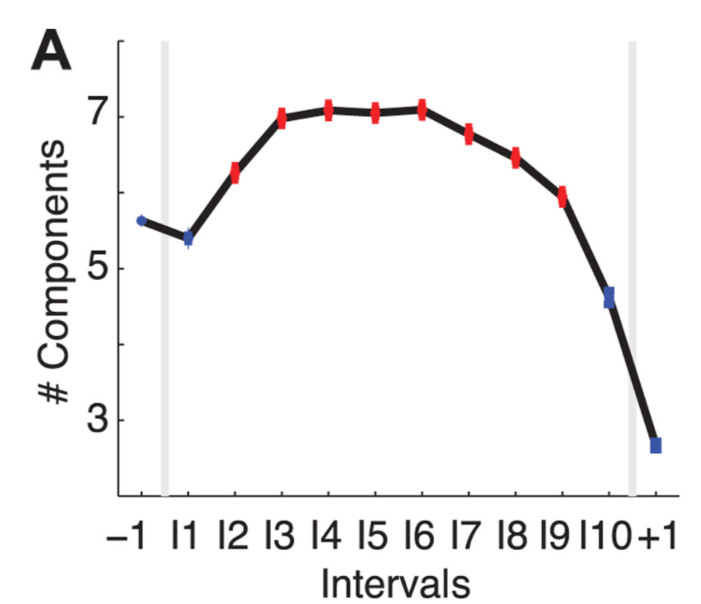
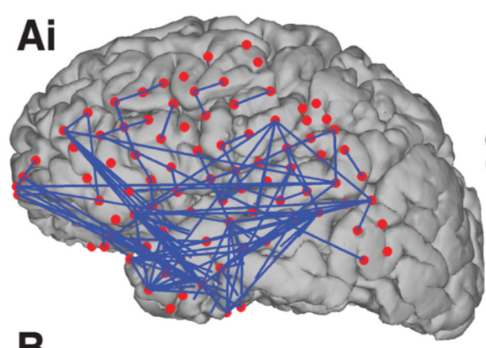
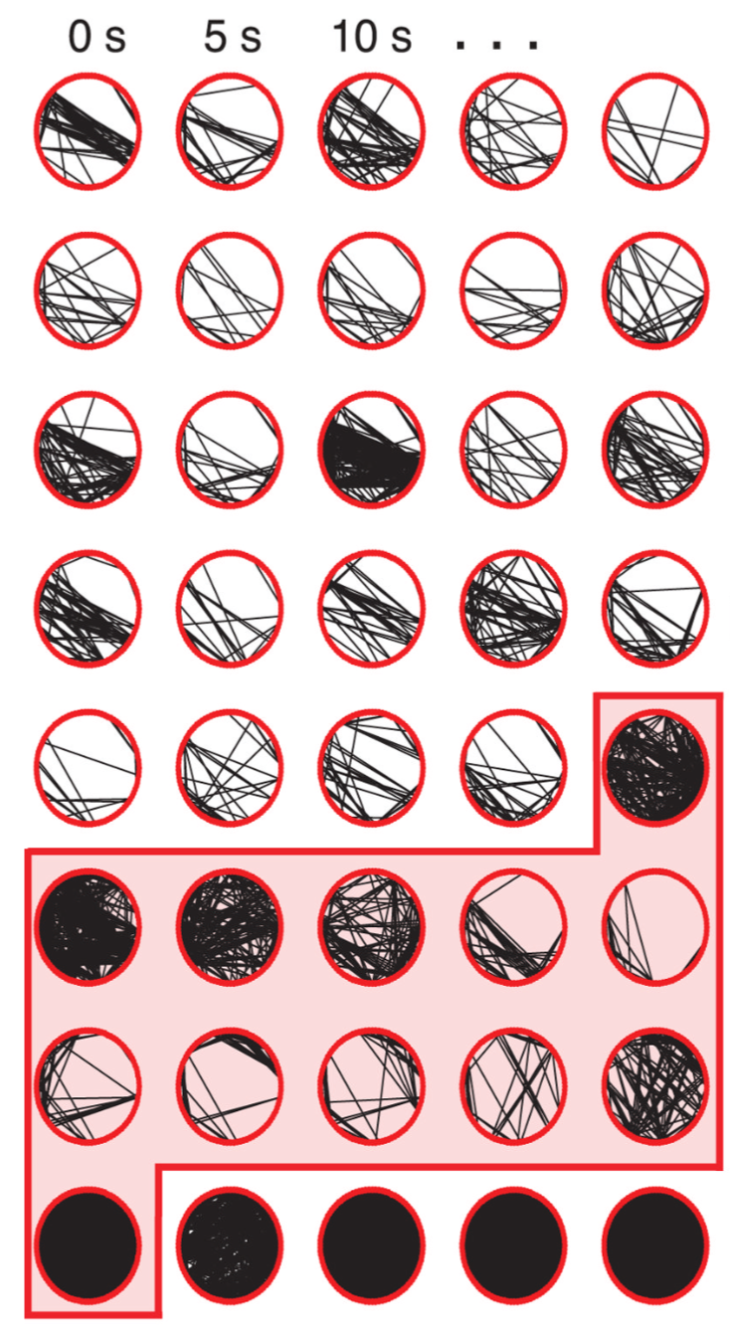
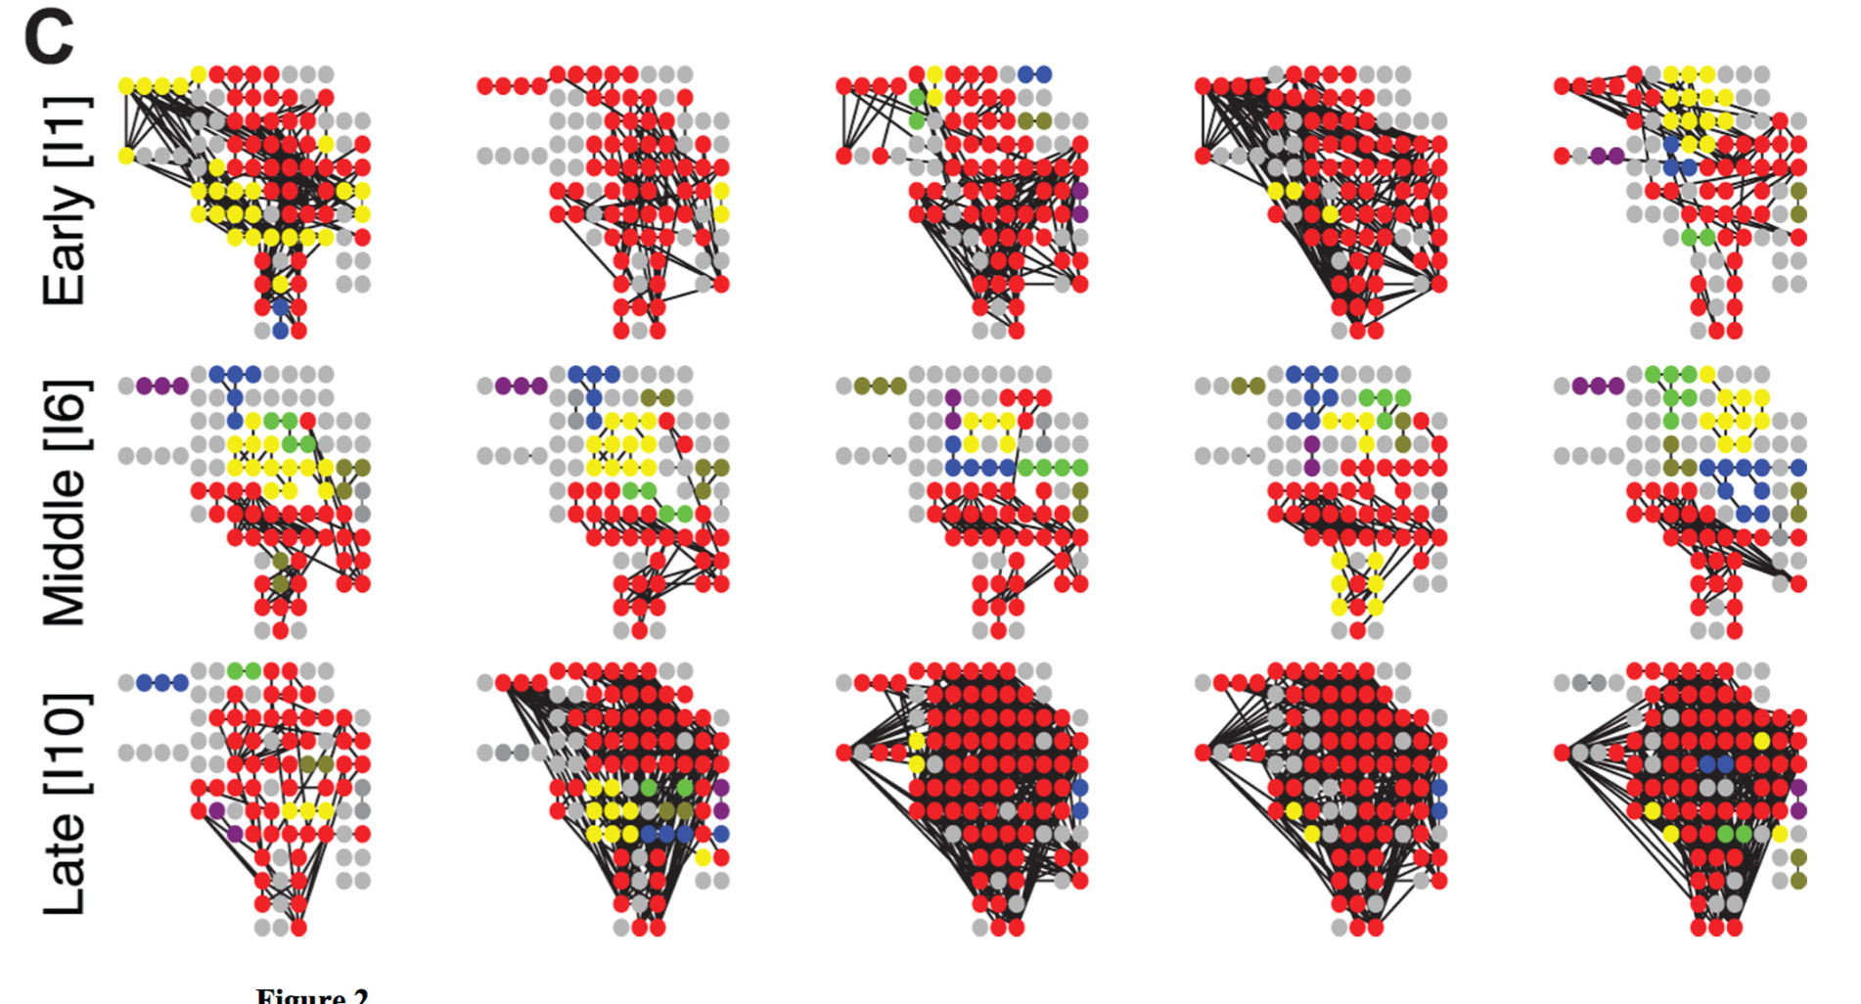

Slide 13
Zubler et al, Brain Topogr 2015

Slide 14
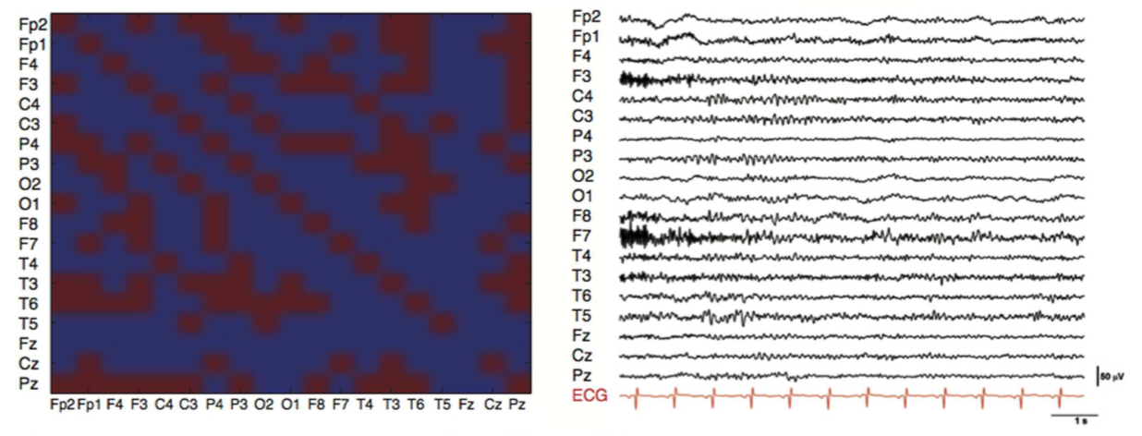
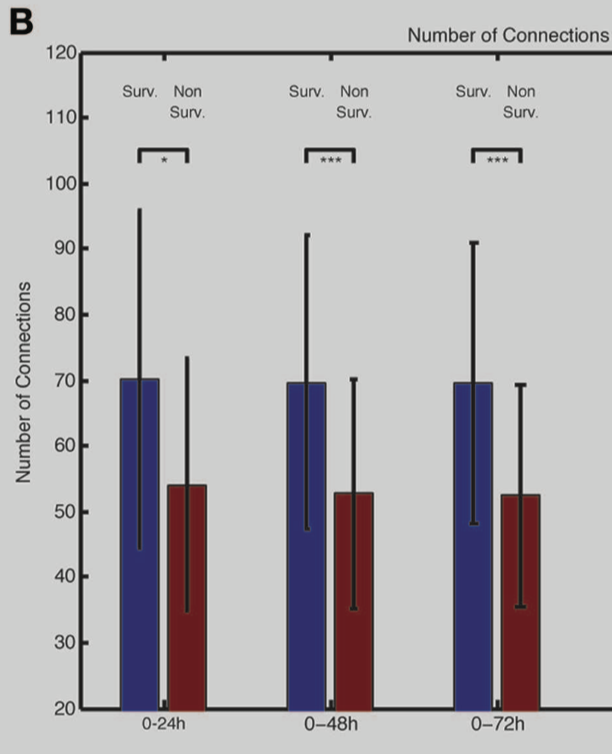
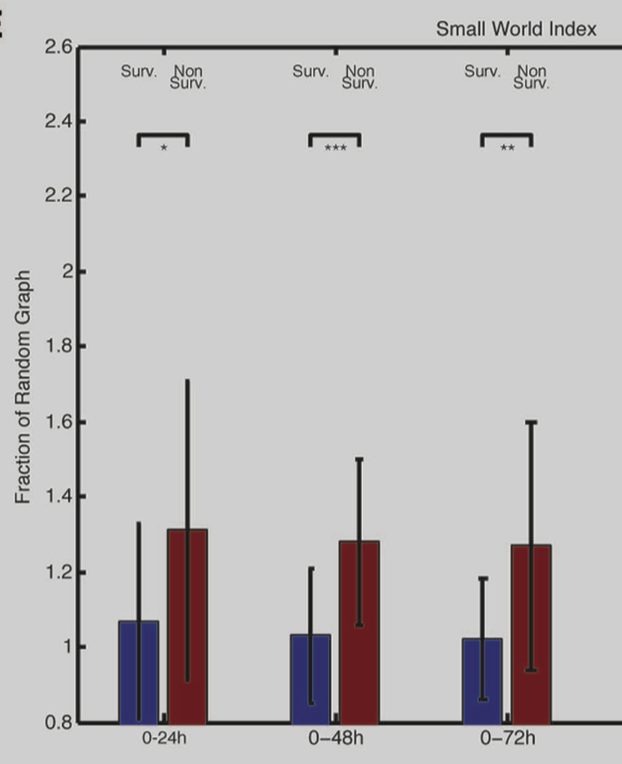
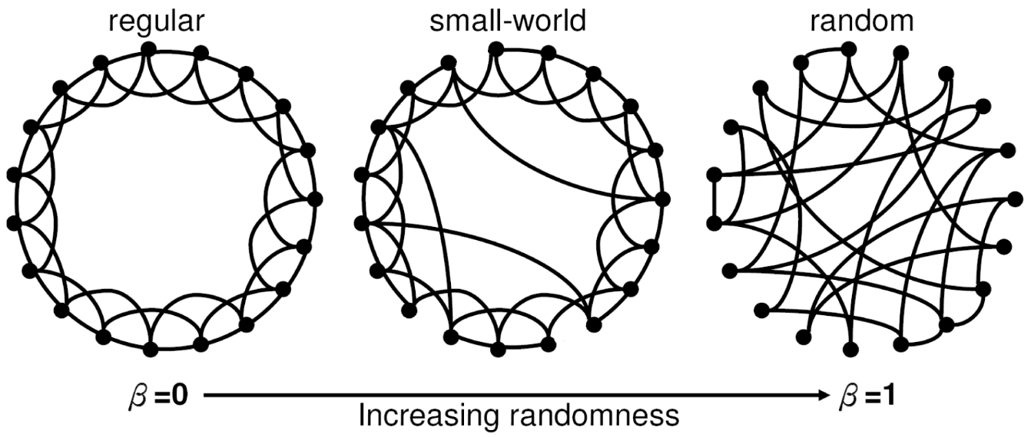
Coma after Cardiac Arrest
Beudel et al, Front Neurol 2014

Slide 15
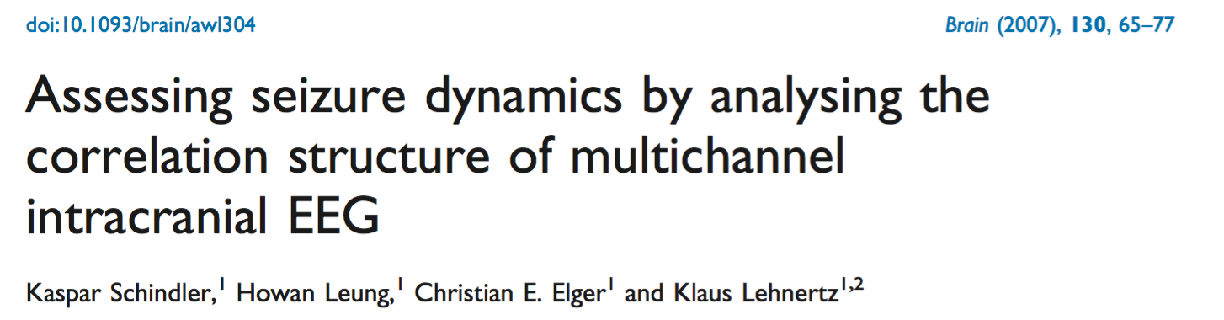
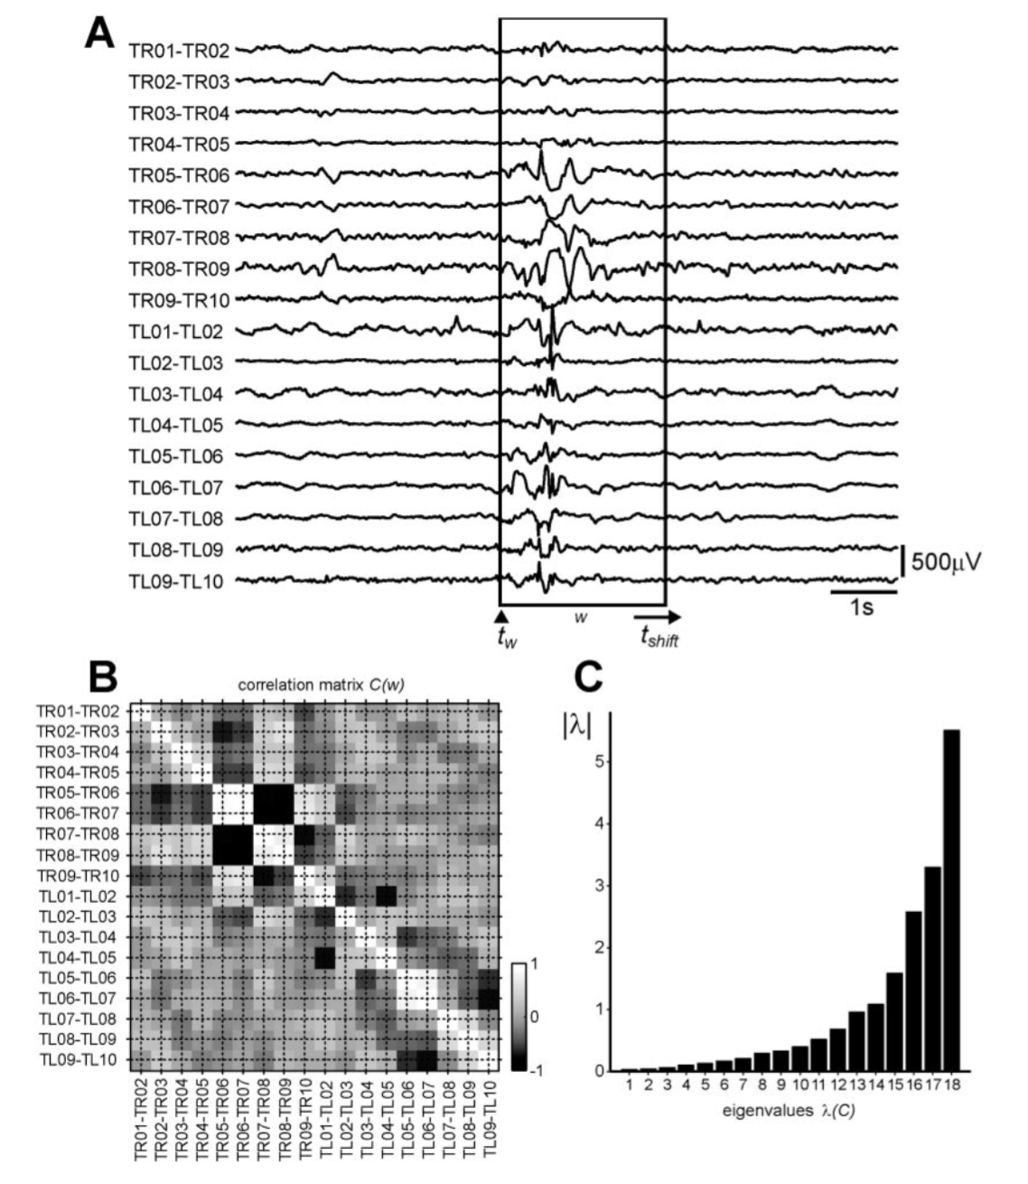
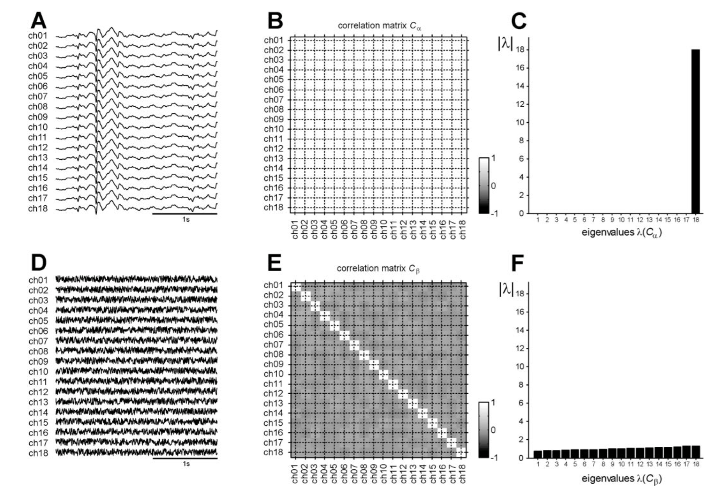
Eigenvalues of the correlation matrix

Slide 16
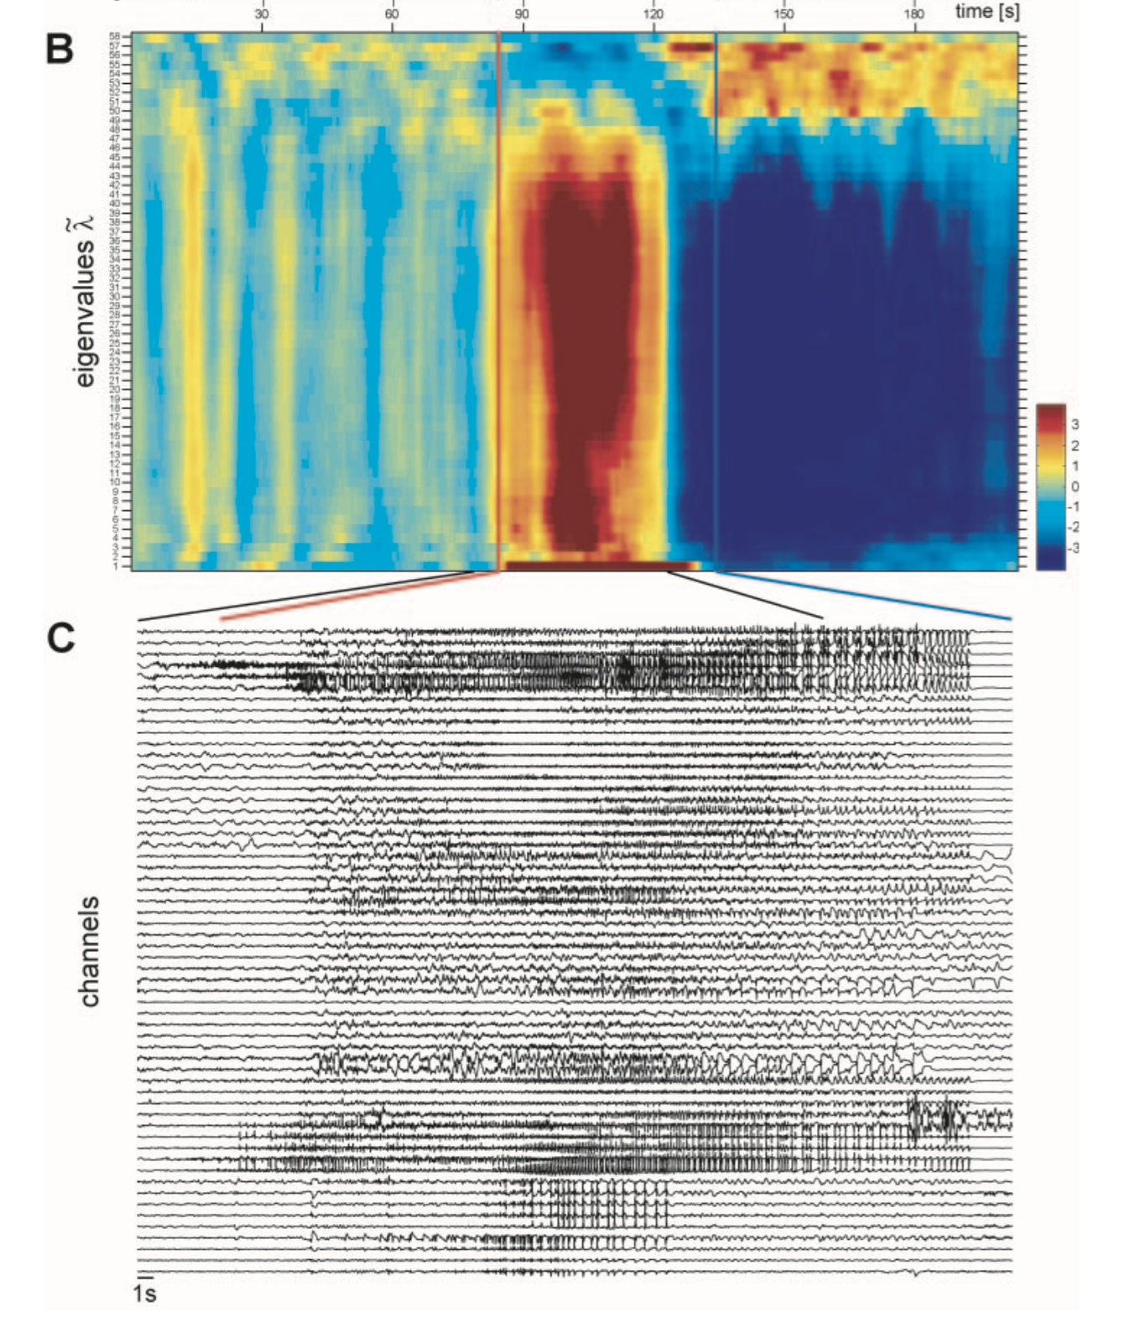
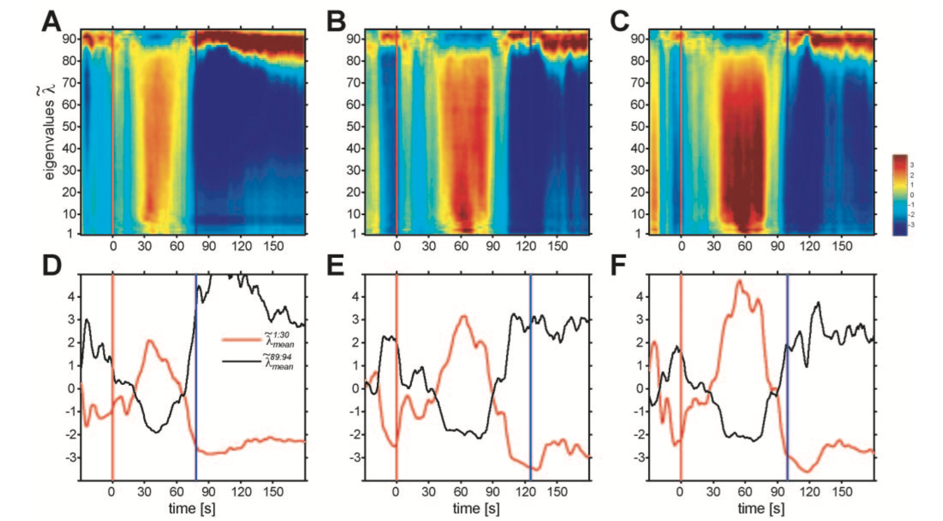

Slide 17
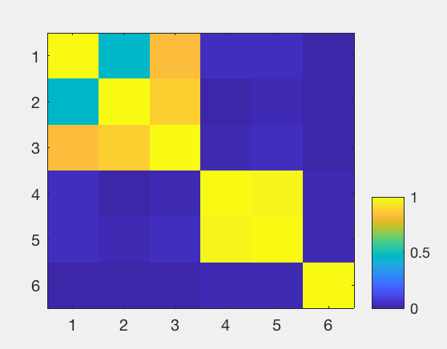
Matlab exercise 1:
Graph of correlation matrix
% 2 mini clusters and one isolated signal
s1 = rand(1000,1);
s2 = 0.5*s1 + rand(1000,1);
s3 = s1 + s2;
s4 = rand(1000,1);
s5 = 4*s4+rand(1000,1);
s6 = rand(1000,1);
% correlation matrix
C = corrcoef([s1,s2,s3,s4,s5,s6]);
C = abs(C);
% plot
subplot(3,1,1)
imagesc(C); colorbar; caxis([0,1])

Slide 18
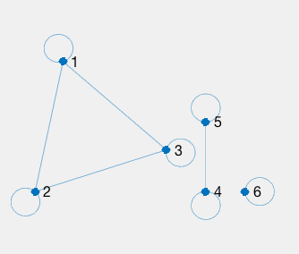
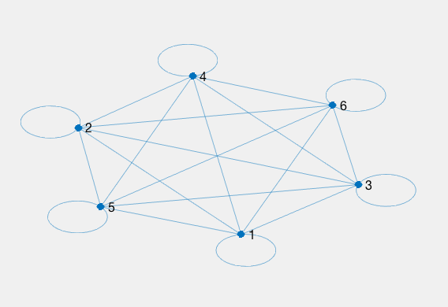
Matlab exercise 1:
Binary graph
% correlation matrix
C = corrcoef([s1,s2,s3,s4,s5,s6]);
C = abs(C);
% thresholding
B = C;
B(B<0.1) = 0;
% graph in Matlap
g = graph(B)
subplot(3,1,2)
plot(g)

Slide 19
Matlab exercise 1:
Binary graph
% correlation matrix
C = corrcoef([s1,s2,s3,s4,s5,s6]);
C = abs(C);
% thresholding
B = C;
B(B<0.1) = 0;
% graph in Matlap
g = graph(B)
subplot(3,1,2)
plot(g)

Slide 20
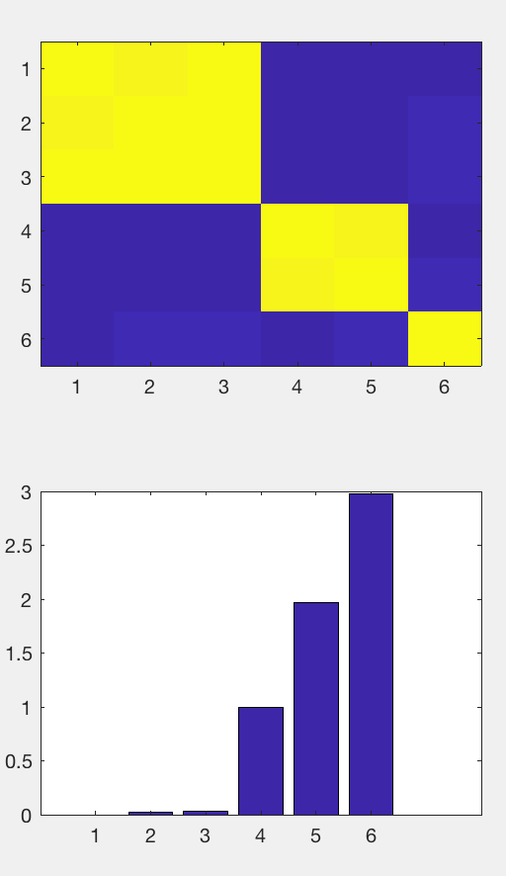
Matlab exercise 1:
Eigenvectors of the correlation matrix
% 2 mini clusters and one isolated signal
s1 = rand(1000,1);
s2 = 5*s1 + rand(1000,1);
s3 = s1 + s2;
s4 = rand(1000,1);
s5 = 4*s4+rand(1000,1);
s6 = rand(1000,1);
% compute correlation matrix
C = corrcoef( [s1,s2,s3,s4,s5,s6] );
C = abs(C);
% eigenvalues of correlation matrix
lambda = eig(C);
lambda= abs(lambda);
lambda= sort(lambda);
% plot
subplot(2,1,1); imagesc(C)
subplot(2,1,2); bar(lambda)

Slide 21
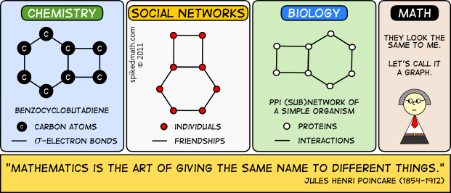
Thank you for your attention !
spikedmath.com

