Slide 1
High Frequency Oscillations (HFO)
Frédéric Zubler
Neurologie Inselpital
Benesco 2018
Notes:
.

Slide 2
Definitions HFO (high frequency oscillations):
HFO = EEG brain activity with frequency > 80 Hz
Ripples : 80-250 Hz
Fast Ripples : 250 – 600 Hz -> specific to epileptic tissue
HFO ≠ tonic beta and gamma activity at seizure onset

Slide 3
Navarrete et al.,
Journal of Physiology – Paris 2017

Slide 4
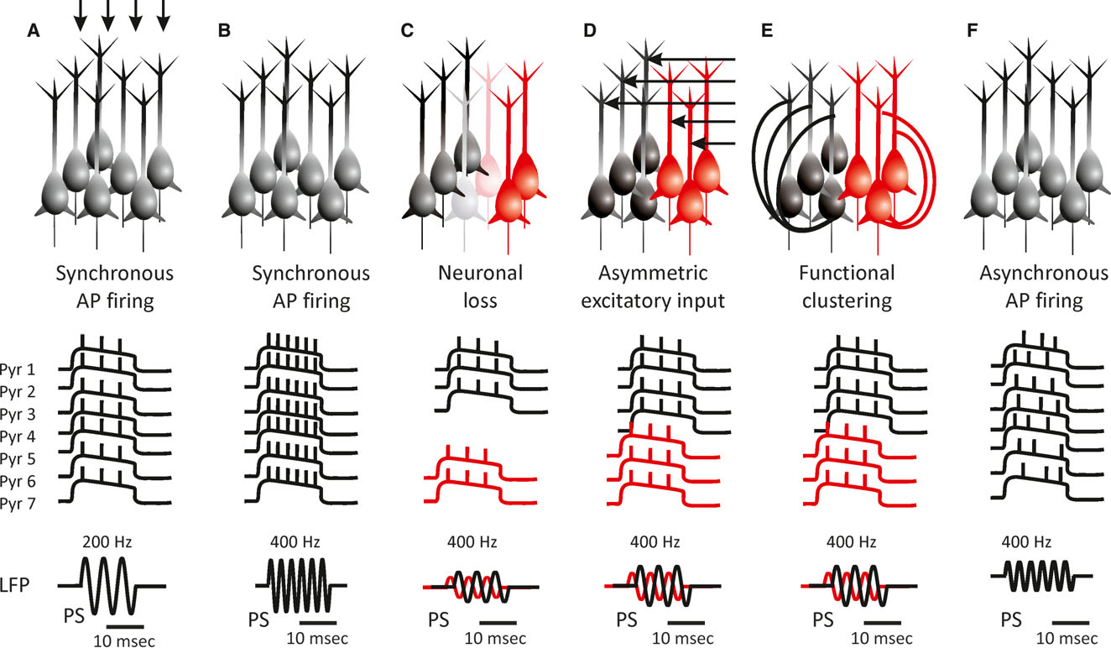
Potential cellular and network mechanisms (1/2) : excitatory neurons
Jiruska et al.,
Epilepsia 2017
Notes:
HFO are probably produced by paramidal cells. Various hypothesis, the main ones are : synchronization of fast firing among population connected by gap junctions, or ephatic interactions. However, maximum firing rate of pyramidal neurons is 300Hz. So postulated existence of different subpopulations of synchronized delay with delayed phase. Exact mechanisms unclear, mainly due to limited technology, for instance calcium imaging does not work at this fast frequency -> rely on computer models. Models show that fast ripple are generic feature of desynchonized networks.
Experimental work shows that changing the concentration of Ca, change frequency from 100 to 300 Hz in in vitro studies.

Slide 5
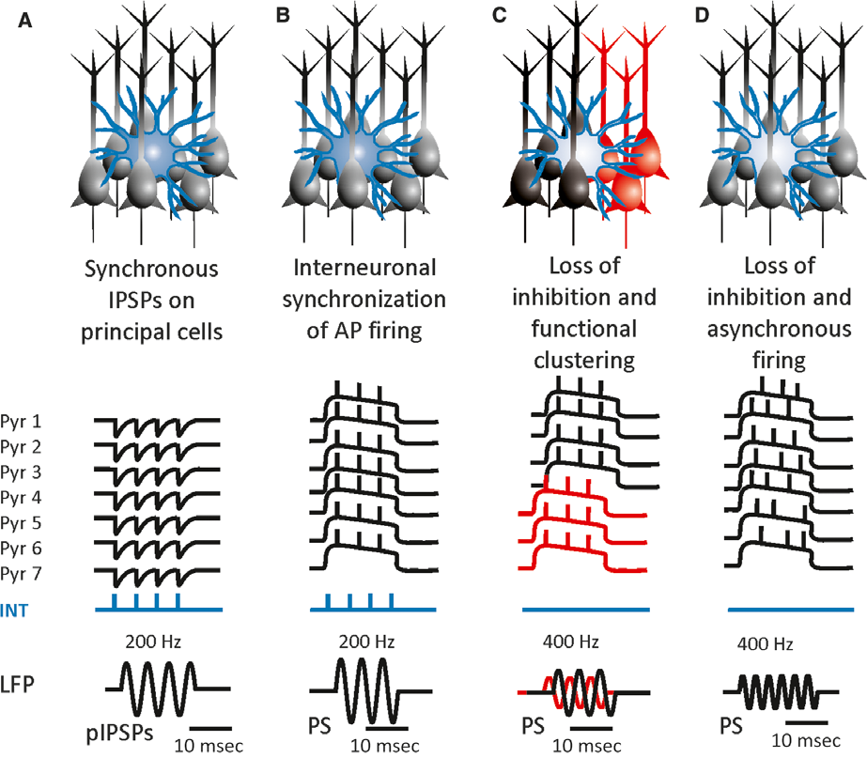
Potential cellular and network mechanisms (2/2) : inhibitory neurons
Jiruska et al.,
Epilepsia 2017
Notes:
Alos therories that implicate inhibitory neurons. We know from various experiments that inhibitory neurons are mainly respondable for low amplitude fast oscillation in low gamma observed at seizure onset. However, blocking fast inhibition with tetanus toxin does not prevent ripples.

Slide 6
Clinical implications of interictal HFOs
Marker of epileptogenesis:
Apparition of HFO are predictor of development of epilepsy in various animal models of epilepsy
Earlier apparition is a predictor of status epilepticus
Association with Spikes
Associated with interictal and ictal spikes
Marker of seizure occurrence and progression
Better correlated with seizure than spikes
Reduced HFO with drugs
Marker of epileptogenic zone
Better markers of epileptogenic zone than spikes (?)
Resection of area with high interictal HFO rate is associated with good postsurgical seizure outcome (?)

Slide 7
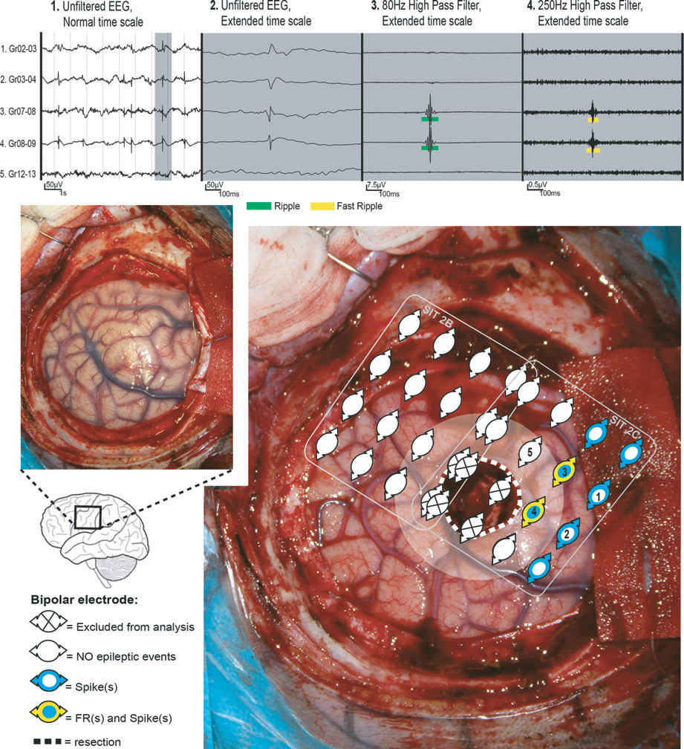
Clinical implications of interictal HFOs
-> BIG HOPE : Implication for epilepsy surgery
(marker for epileptogenic zone desperately needed)
Frauscher et al., Epilepsia 2017

Slide 8
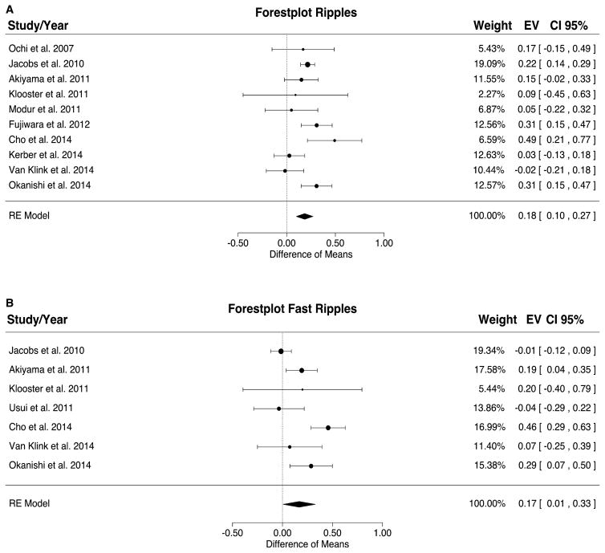
Clinical implications of interictal HFOs
Meta analysis: difference in ratio of channels with HFO resected
between patiens with good vs. bad outcome
Frauscher et al., Epilepsia 2017

Slide 9
Clinical implications of ictal HFOs
Marker of seizure progression:
- Ictal propagation of HFO corresponds to semiology of Jacksonian march
Marker of epileptogenic zone
- Resection of area high ictal HFO rate is associated with good postsurgical seizure outcome
Resection of area with coupling ictal HFO – Phase low Frequency is associated with good postsurgical seizure outcome

Slide 10
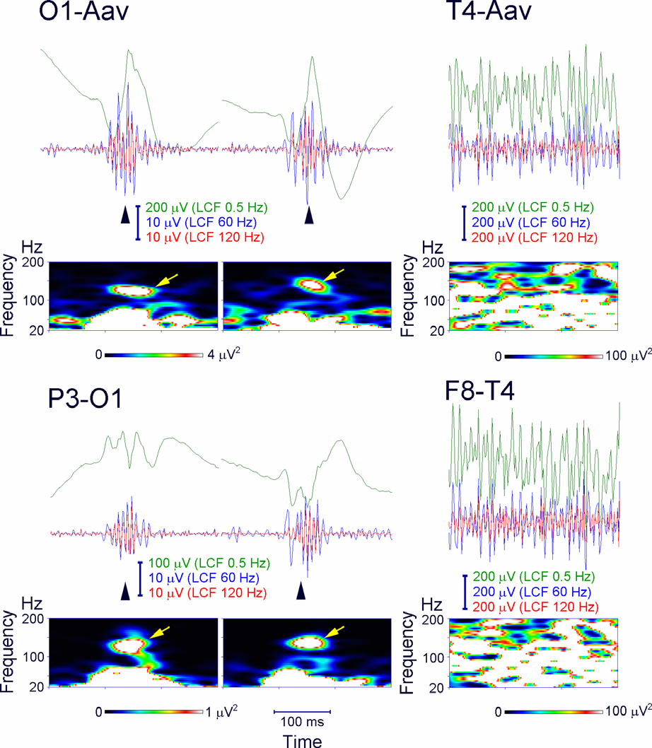
Non-invasive methods:
Sclap EEG
MEG
Frauscher et al., Epilepsia 2017

Slide 11
Differentiation between physiological and pathological interictal HFOs
Based on :
- Frequency (Cave! different frequencies in diff. cortical area)
- Coupling with spikes (are pathological if coupling, dependency on phase)
- Coupling with slow waves (sleep)
- …
However: it is difficult to differentiate pathological from physiological HFOs, especially in Hippocampus, because HFOs are registered by cognitive task (memorization !).

Slide 12
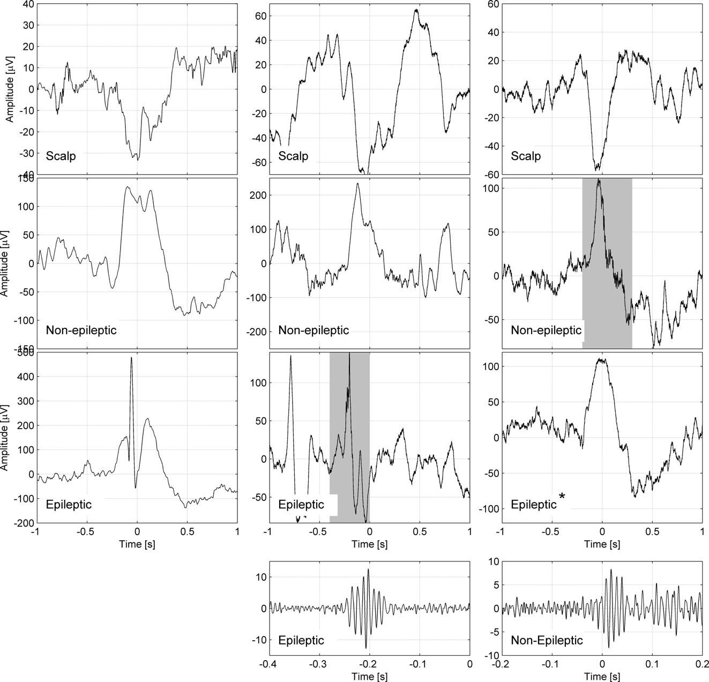
Differentiation between physiological and pathological interictal HFOs
Frauscher et al., Epilepsia 2017

Slide 13
Automatic detection (Navarrete et al):
1. Preprocessing: band-pass filtering
2. Selection of events from the background
(i) monitoring the energy variation
- Root mean squared
- Line length
- Envelope
(ii) highlight events
- Exceeds threshold (SD, percentile, ...)
- Minimal duration / number of oscillations
3. Reject false events
- visual control
- “blob” in time-frequency representation

Slide 14
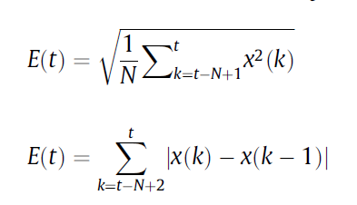
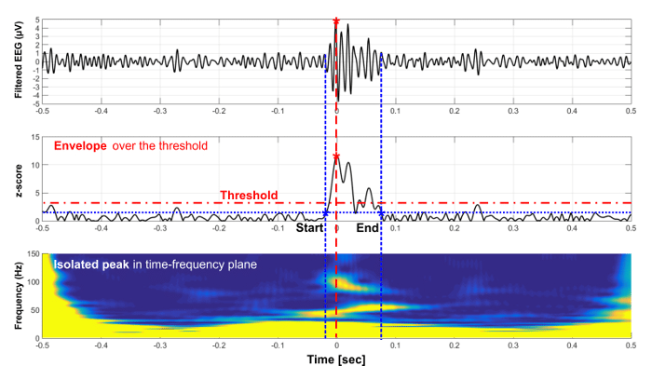
Automatic detection (Navarrete et al):
1. Preprocessing: band-pass filtering
2. Selection of events from the background
(i) monitoring the energy variation
- Root mean squared
- Line length
- Envelope
(ii) highlight events
- Exceeds threshold (SD, percentile, ...)
- Minimal duration/nb oscillations
3. Reject false events
- visual control
- “blob” in time-frequency representation

Slide 15
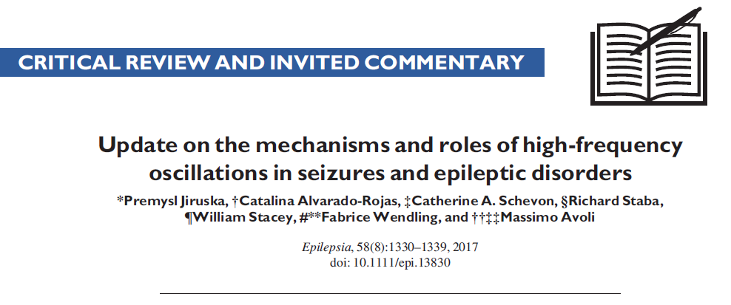

Ref 1: Physiological aspects
Ref 2: Clinical aspects

